Slide 1
Algorithms: Divide and Conquer
For: CSCI 163A / COEN 179
By: Navid Shaghaghi

Slide 2
Divide-and-Conquer
A divide-and-conquer algorithm solves a problem by
dividing its given instance into several smaller instances,
solving each of them recursively,
and then if necessary, combining the solutions to the smaller instances into a solution to the given instance.

Slide 3
a problem of size n
subproblem 1
of size n/2
subproblem 2
of size n/2
a solution to
subproblem 1
a solution to
subproblem 2
a solution to
the original problem

Slide 4
General Recurrence
Assuming that all smaller instances have the same size n/b, with “a” of them being actually solved, for n = b^{k}, k = 1, 2, . . . we have :
T (n) = aT (n/b) + f (n)
where
a ≥ 1,
b ≥ 2, and
f(n) is a function that accounts for the time spent on dividing the problem into smaller ones and combining their solutions.

Slide 5
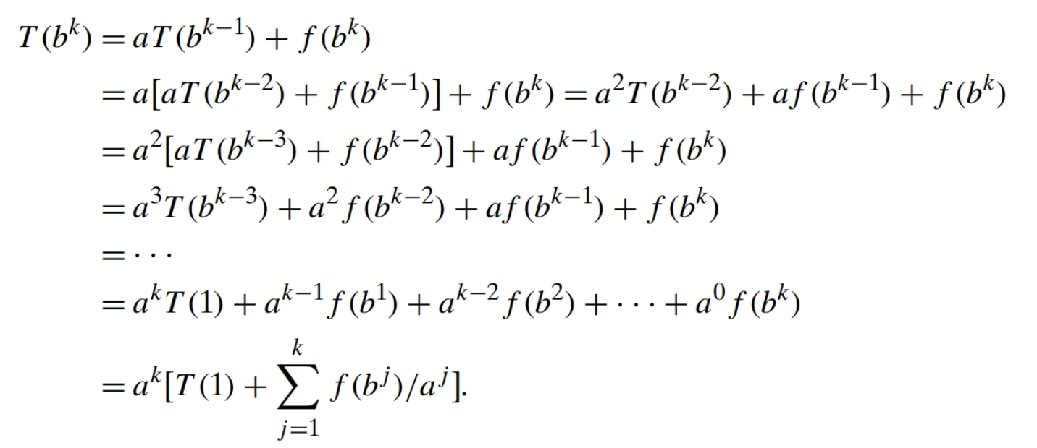
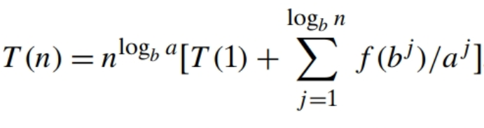
Solving using Backward Substitution:
Since n = b^{k} → k = log_{b}n → a^{k} = a^{logbn} = n^{logba} we get:

Slide 6
Eventually Nondecreasing
Let f(n) be a nonnegative function defined on the set of natural numbers. f(n) is called eventually nondecreasing if there exists some nonnegative integer n₀ for which f(n) is nondecreasing on the interval [n₀, ∞).
f(n₁) ≤ f(n₂) for all n₂ > n₁ ≥ n₀
Example:
(n − 100)² is eventually nondecreasing, although it is decreasing on the interval [0, 100]
sin²(πn)/2 is not
Note:
The vast majority of functions we encounter in the analysis of algorithms are eventually nondecreasing. Most of them are, in fact, nondecreasing on their entire domains.

Slide 7
Smoothness
Let f(n) be a nonnegative function defined on the set of natural numbers. f(n) is called smooth if it is
eventually nondecreasing and
f(2n) ∈ Θ(f(n)).
log n, n, nlogn, and n^{α} where α ≥ 0 are smooth.
Example: f(2n) = 2n log 2n = 2n(log 2 + log n) = (2 log 2)n + 2n log n ∈ Θ(n log n).
Fast-growing functions, such as a^{n} where a > 1 and n!, are not smooth.
Example: f(2n) = 2^{2n} = 4^{n} ∉ Θ(2^{n}).

Slide 8
Sandwich Theorem
Let f(n) be a smooth function. Then for any fixed integer b ≥ 2,
f(bn) ∈ Θ(f(n)),
i.e., there exist positive constants c_{b} and d_{b} and a nonnegative integer n₀ such that:
d_{b}f(n) ≤ f(bn) ≤ c_{b}f(n) for n ≥ n₀.
The same assertion holds for the O and Ω notations.
Proof: See Page 489

Slide 9
Smoothness Rule
Let T(n) be an eventually nondecreasing function and f(n) be a smooth function.
If T(n) ∈ Θ(f(n)) for values of n that are powers of b where b ≥ 2, then T(n) ∈ Θ (f(n)).
The same assertion holds for the O and Ω notations.
Proof: See page 490

Slide 10
Master Theorem
Let T(n) be an eventually nondecreasing function that satisfies the recurrence T(n) = aT(n/b) + f(n) for n = b^{k}, k=1,2,... and T(1) = c,
where a ≥ 1, b ≥ 2, c > 0. If f(n) ∈ Θ(n^{d} ) where d ≥ 0, then
Analogous results hold for the O and Ω notations, as well.

Slide 11
Examples
T(n) = 4T(n/2) + n ⇒ T(n) ∈ ?
T(n) = 4T(n/2) + n² ⇒ T(n) ∈ ?
T(n) = 4T(n/2) + n³ ⇒ T(n) ∈ ?

Slide 12
Example

